Slide 1

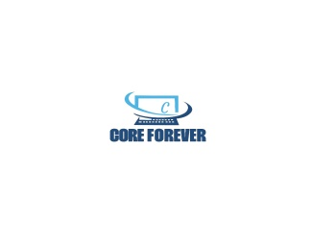
Explosive retrieval diffusion and disposal
Robot
Core Forever
1

Slide 2
Problem statement
In Today’s world the people’s safety and security is paramount, due to development of explosive materials
Many have suffered injuries, loss of life, and psychological trauma due to these threats.
I aim to leverage technology to create a safer environment for everyone, especially those who have been affected by such tragedies.
Core Forever
Core Forever
Core Forever
2

Slide 3
Introduction
Robots equipped with advanced sensors and image processing technology can safely identify and neutralize explosive devices from a distance, minimizing risk to human life.
By analyzing visual data from cameras, image processing algorithms can detect unusual patterns or objects that might indicate the presence of a bomb.
Machine learning models are trained on large datasets to recognize and classify potential threats based on visual and sensor data, improving the accuracy of bomb detection systems over time.
Combining robotics with image processing and machine learning enhances the efficiency and effectiveness of bomb detection operations, enabling quicker and more reliable responses to potential threats.
Core Forever
3

Slide 4
Technical Approach
Detection Development
Sensor is currently used to detect or identify explosives Materials .
Machine learning
I²C a serial communication bus that allows multiple devices to communicate with each other using just two wires
Image processing
Cam enables robots to interpret visual data from their environment, allowing them to perform tasks
Cloud data
Amazon web service to collect data and the image processed and transfer data to diffuse bomb
Robotic arm control
NRF24L01 is a radio transceiver module (SPI protocol) used to send and receive data to operate arm
Core Forever
4

Slide 5
Block diagram
Image processing Esp32 cam
Proximity
sensor
Robotic arm
Nrf24l01
controller
Receiver
Transmitter
Mq2
IR
Machine learning
pcf8574
GSM
GPS
Motor driver
Core Forever
5

Slide 6
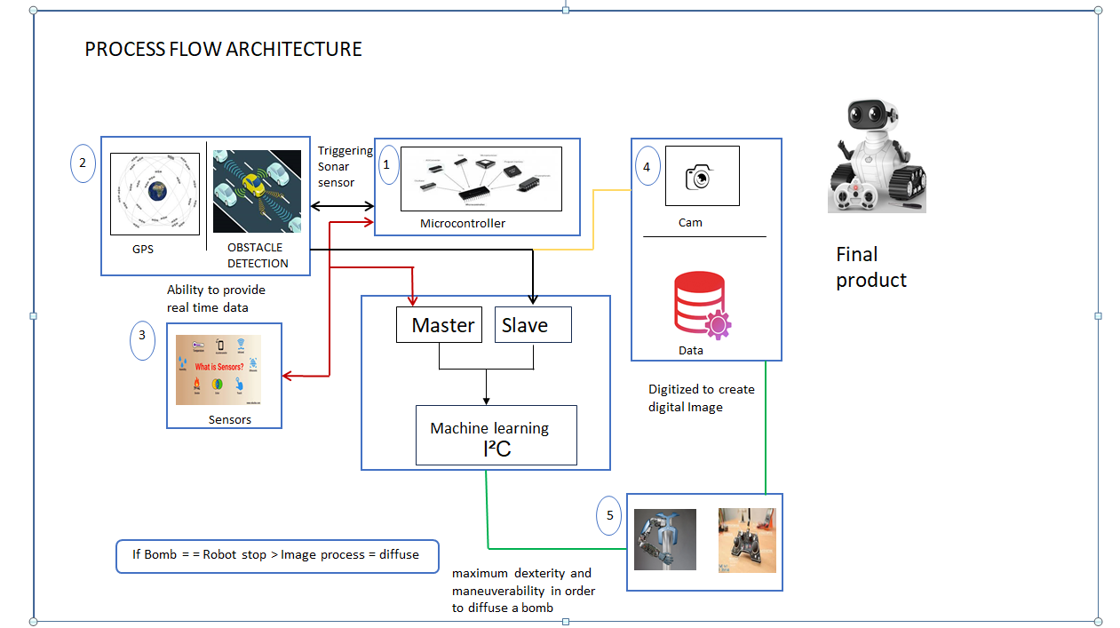

Process Flow Architecture
Core Forever
6

Slide 7
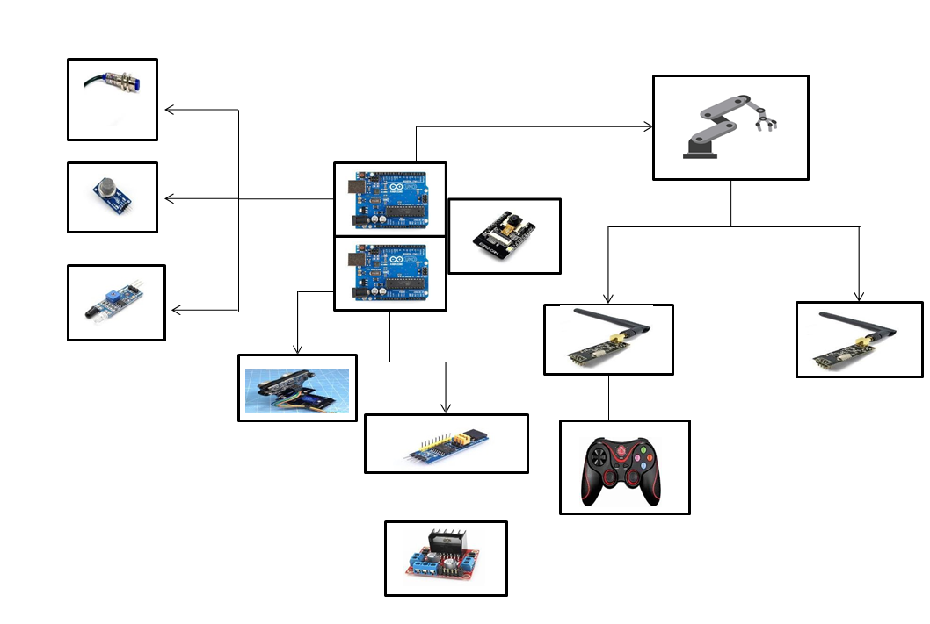
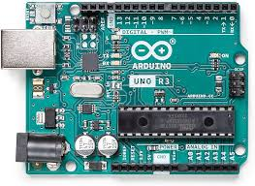
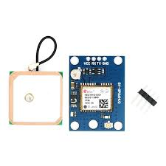
Image Representation
Core Forever
7

Slide 8
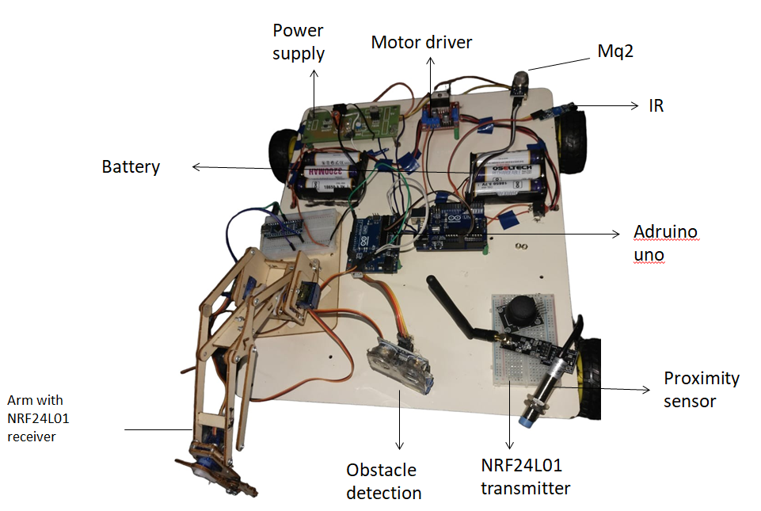
Prototype
Core Forever
8

Slide 9
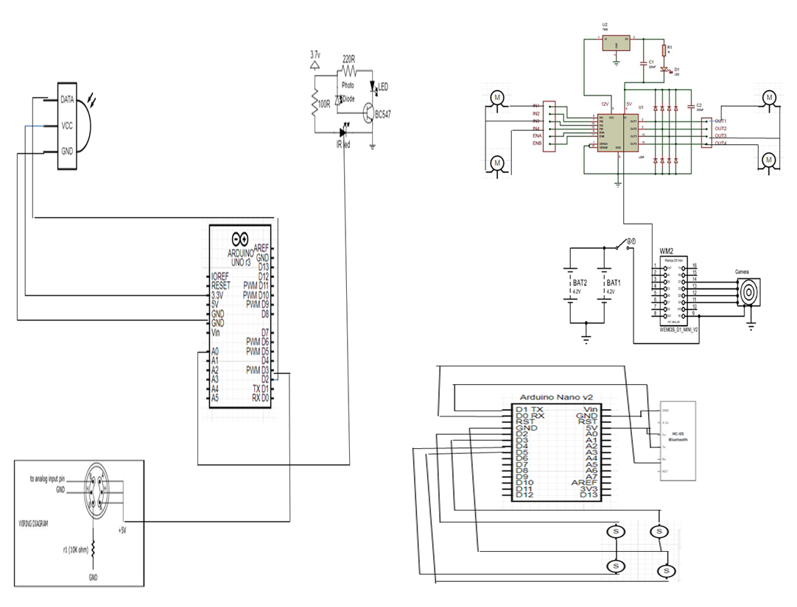
Circuit diagram
Core Forever
9

Slide 10
Target Benefits
ICOR TECHNOLOGY INC.
It is an canada based company which is top most in the production of Military survillance robots
In India
we are going to make it as an product
Which is most benefits to the people and militry persons
Core Forever
11

Slide 11
References
Journals
S.NO | Title | Author | Journal Name
1 | DEVELOPMENT OF SMART ADVANCED BOMB DISPOSAL AND MILITARY SPYING ROBOT | Rahul Desai Prasann Malanaik Vidya Demannavar Vishal Jinarali Shilpa Bhairanatti | International Journal of Research Publication and Reviews
2 | Bomb Detection Robotics using Embedded Controller | Gurdas Karan | International Journal of Mathematics and Computing Research Techniques
website
S.No | Name | Purpose | Link
1 | Science Direcet | To study about explosive materials | https://www.sciencedirect.com/science/article/abs/pii/B9780444522047500201
Core Forever

Slide 12
Conclusion
These robot using machine learning and image processing, the project presents a significant advancement in security and robotics.
The integration of machine learning enables the robot to identify potential threats with greater accuracy through image processing techniques.
By using real-time data from sensors and cameras, the robot can autonomously navigate and detect explosive devices while minimizing human risk.
Future improvements could focus on refining the accuracy of threat detection algorithms and expanding the robot's autonomous capabilities.
Core Forever
12

Slide 13

Core Forever
13

Slide 14


THANKING
YOU
14

